Slide 1
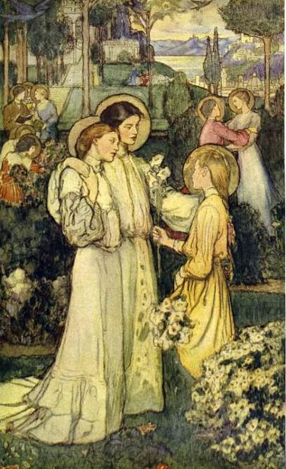
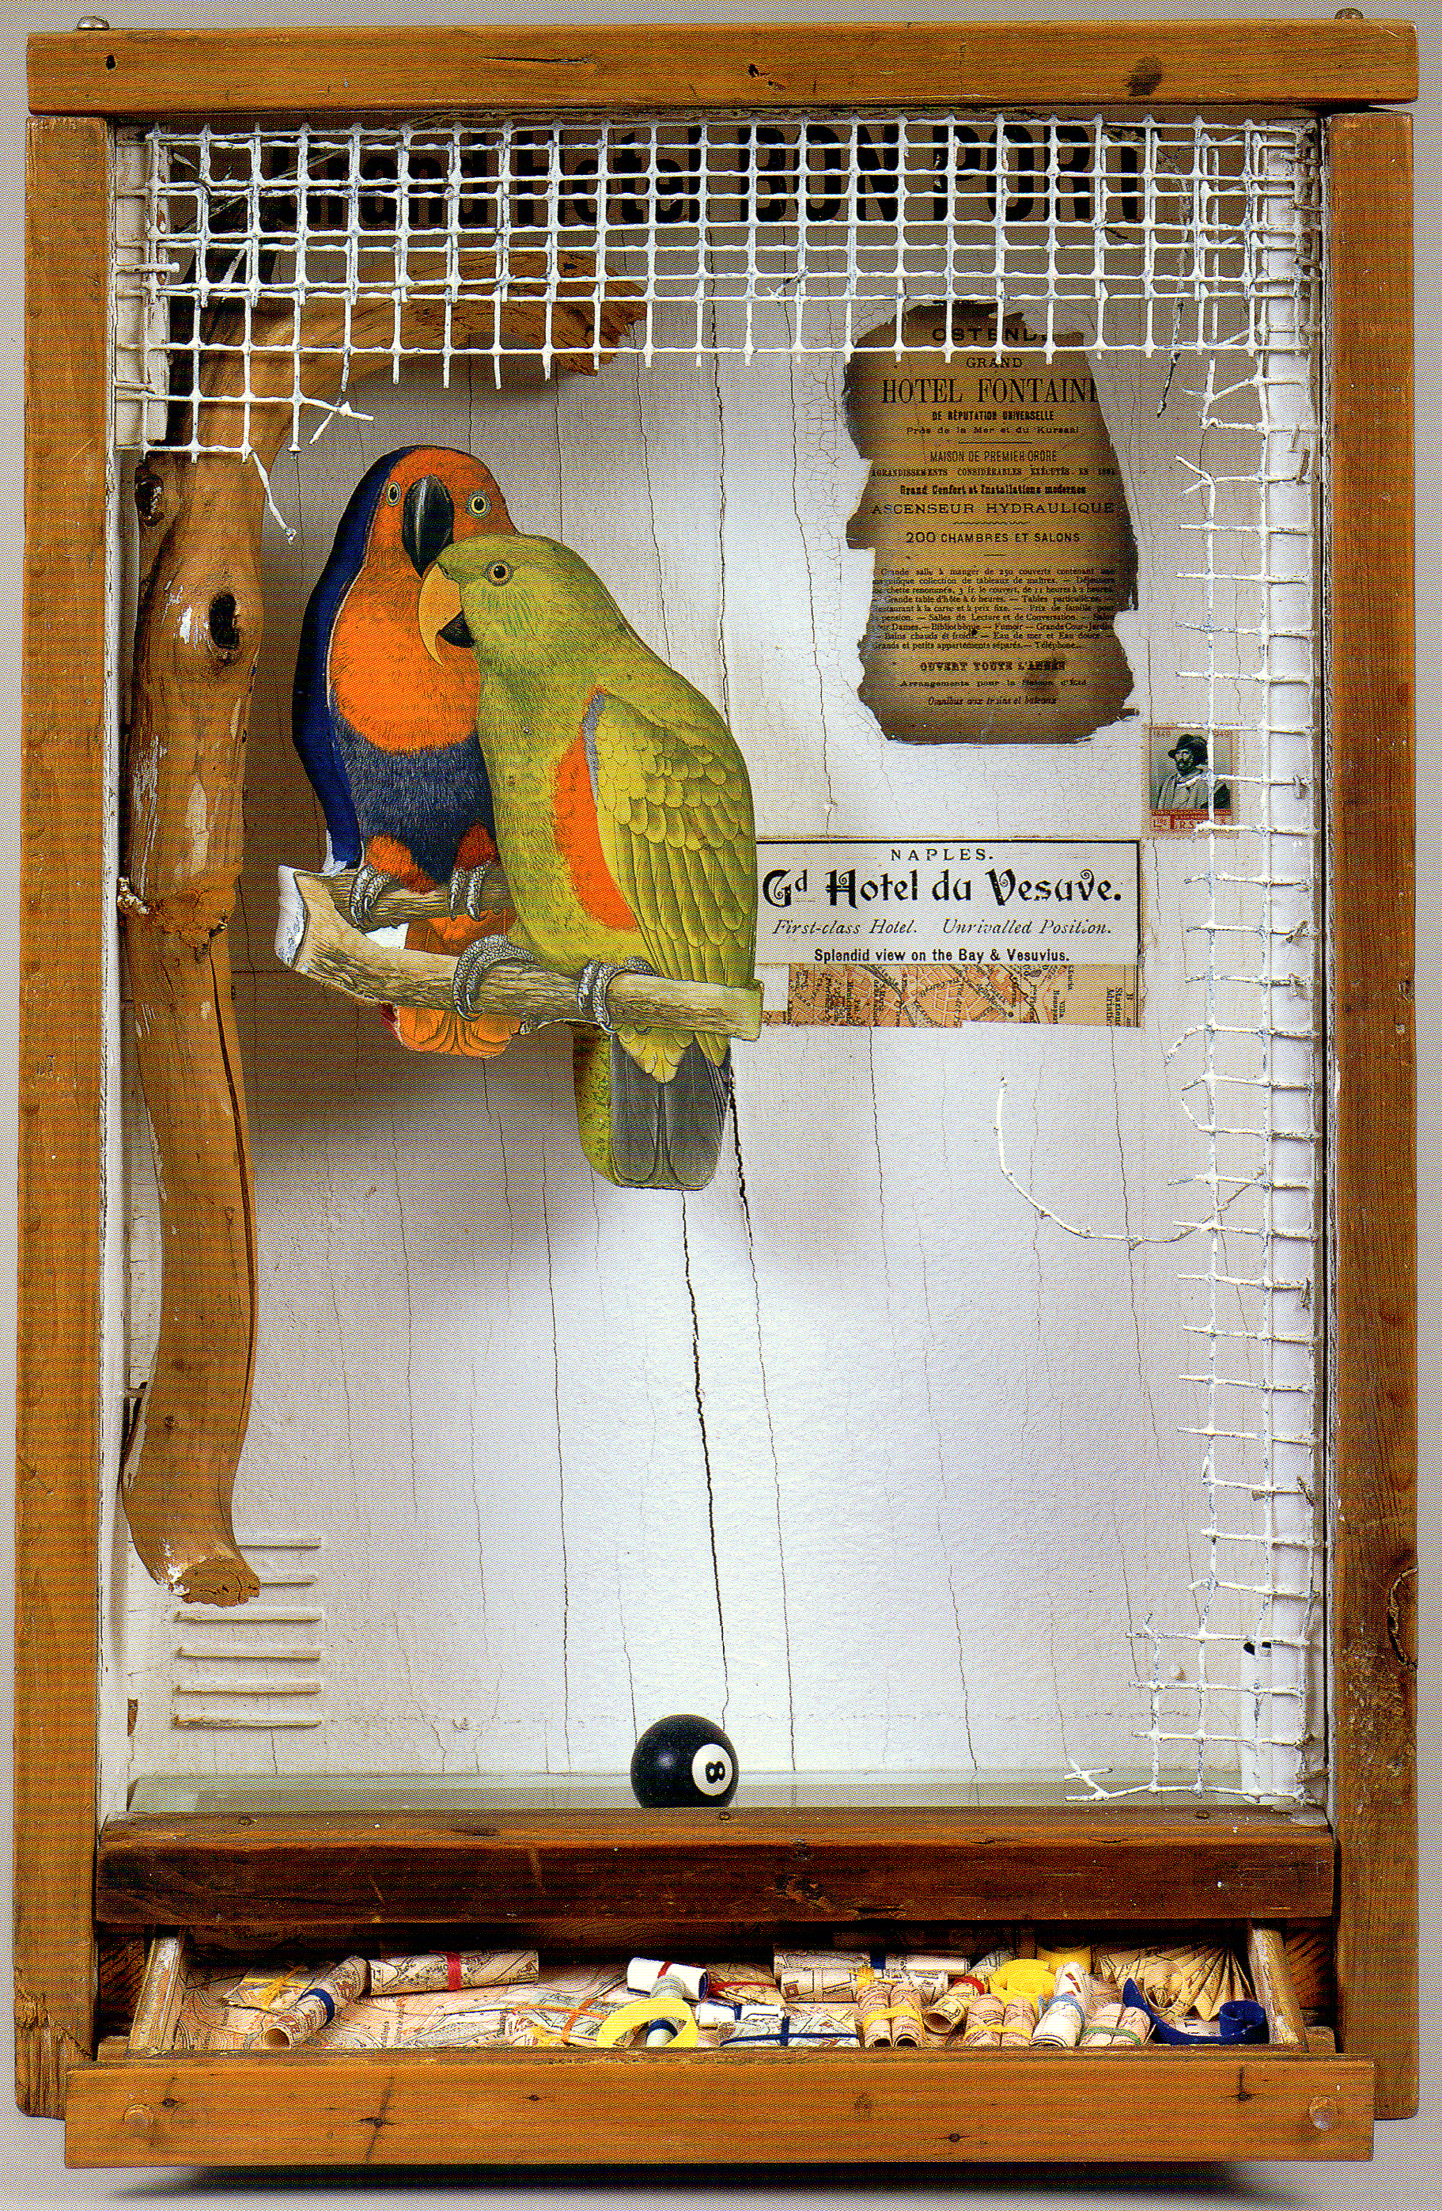
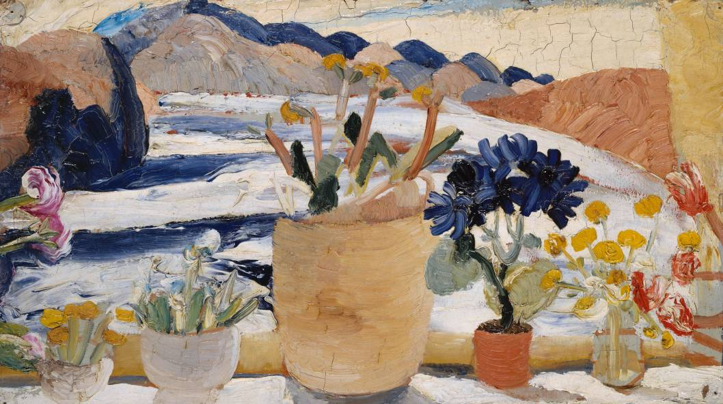
The Christian Scientist as Artist
From Violet Oakley to Joseph Cornell
Massimo Introvigne (UPS, Torino, Italy)

Slide 2
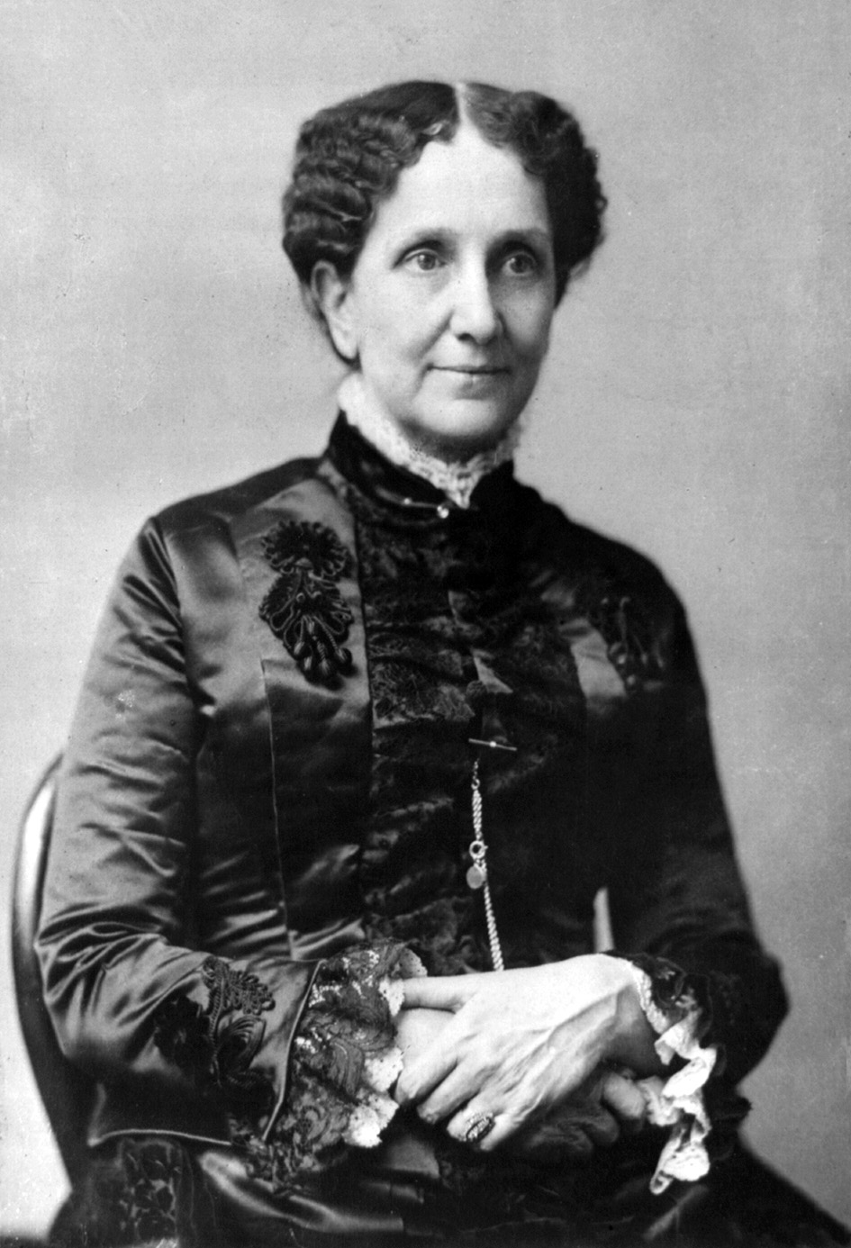
From «Crude» to «Glorious» Forms
«Divine Science, rising above physical theories, excludes matter, resolves things into thoughts, and replaces the objects of material sense with spiritual ideas»
«The crude creations of mortal thought must finally give place to the glorious forms which we sometimes behold in the camera of divine Mind, when the mental picture is spiritual and eternal. Mortals must look beyond fading, finite forms, if they would gain the true sense of things»
Mary Baker Eddy (1821-1910), Science and Health with Key to the Scriptures, 1910 ed., 123 and 263- 264

Slide 3
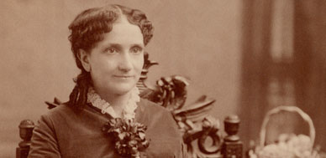
Christian Science and the Arts
«The artist is not in his painting. The picture is the artist's thought objectified»
The Christian Science artists says: «I have spiritual ideals, indestructible and glorious. When others see them as I do, in their true light and loveliness, — and know that these ideals are real and eternal because drawn from Truth, — they will find that nothing is lost, and all is won, by a right estimate of what is real»
Science and Health, 1910 ed., 310 and 359-360

Slide 4
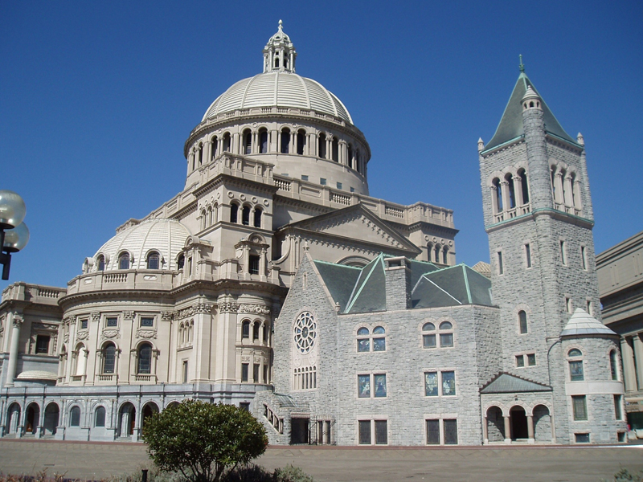
Christian Science Architecture
Translating these principles into an aesthetic was neither easy nor unanimous. As Christian Science grew, it built impressive churches
The founder, without imposing one particular style, recommended that they were based on the Christian tradition. The first were neo-Romanic or neo-Gothic, sometimes with Renaissance or classic elements (Boston, right)

Slide 5
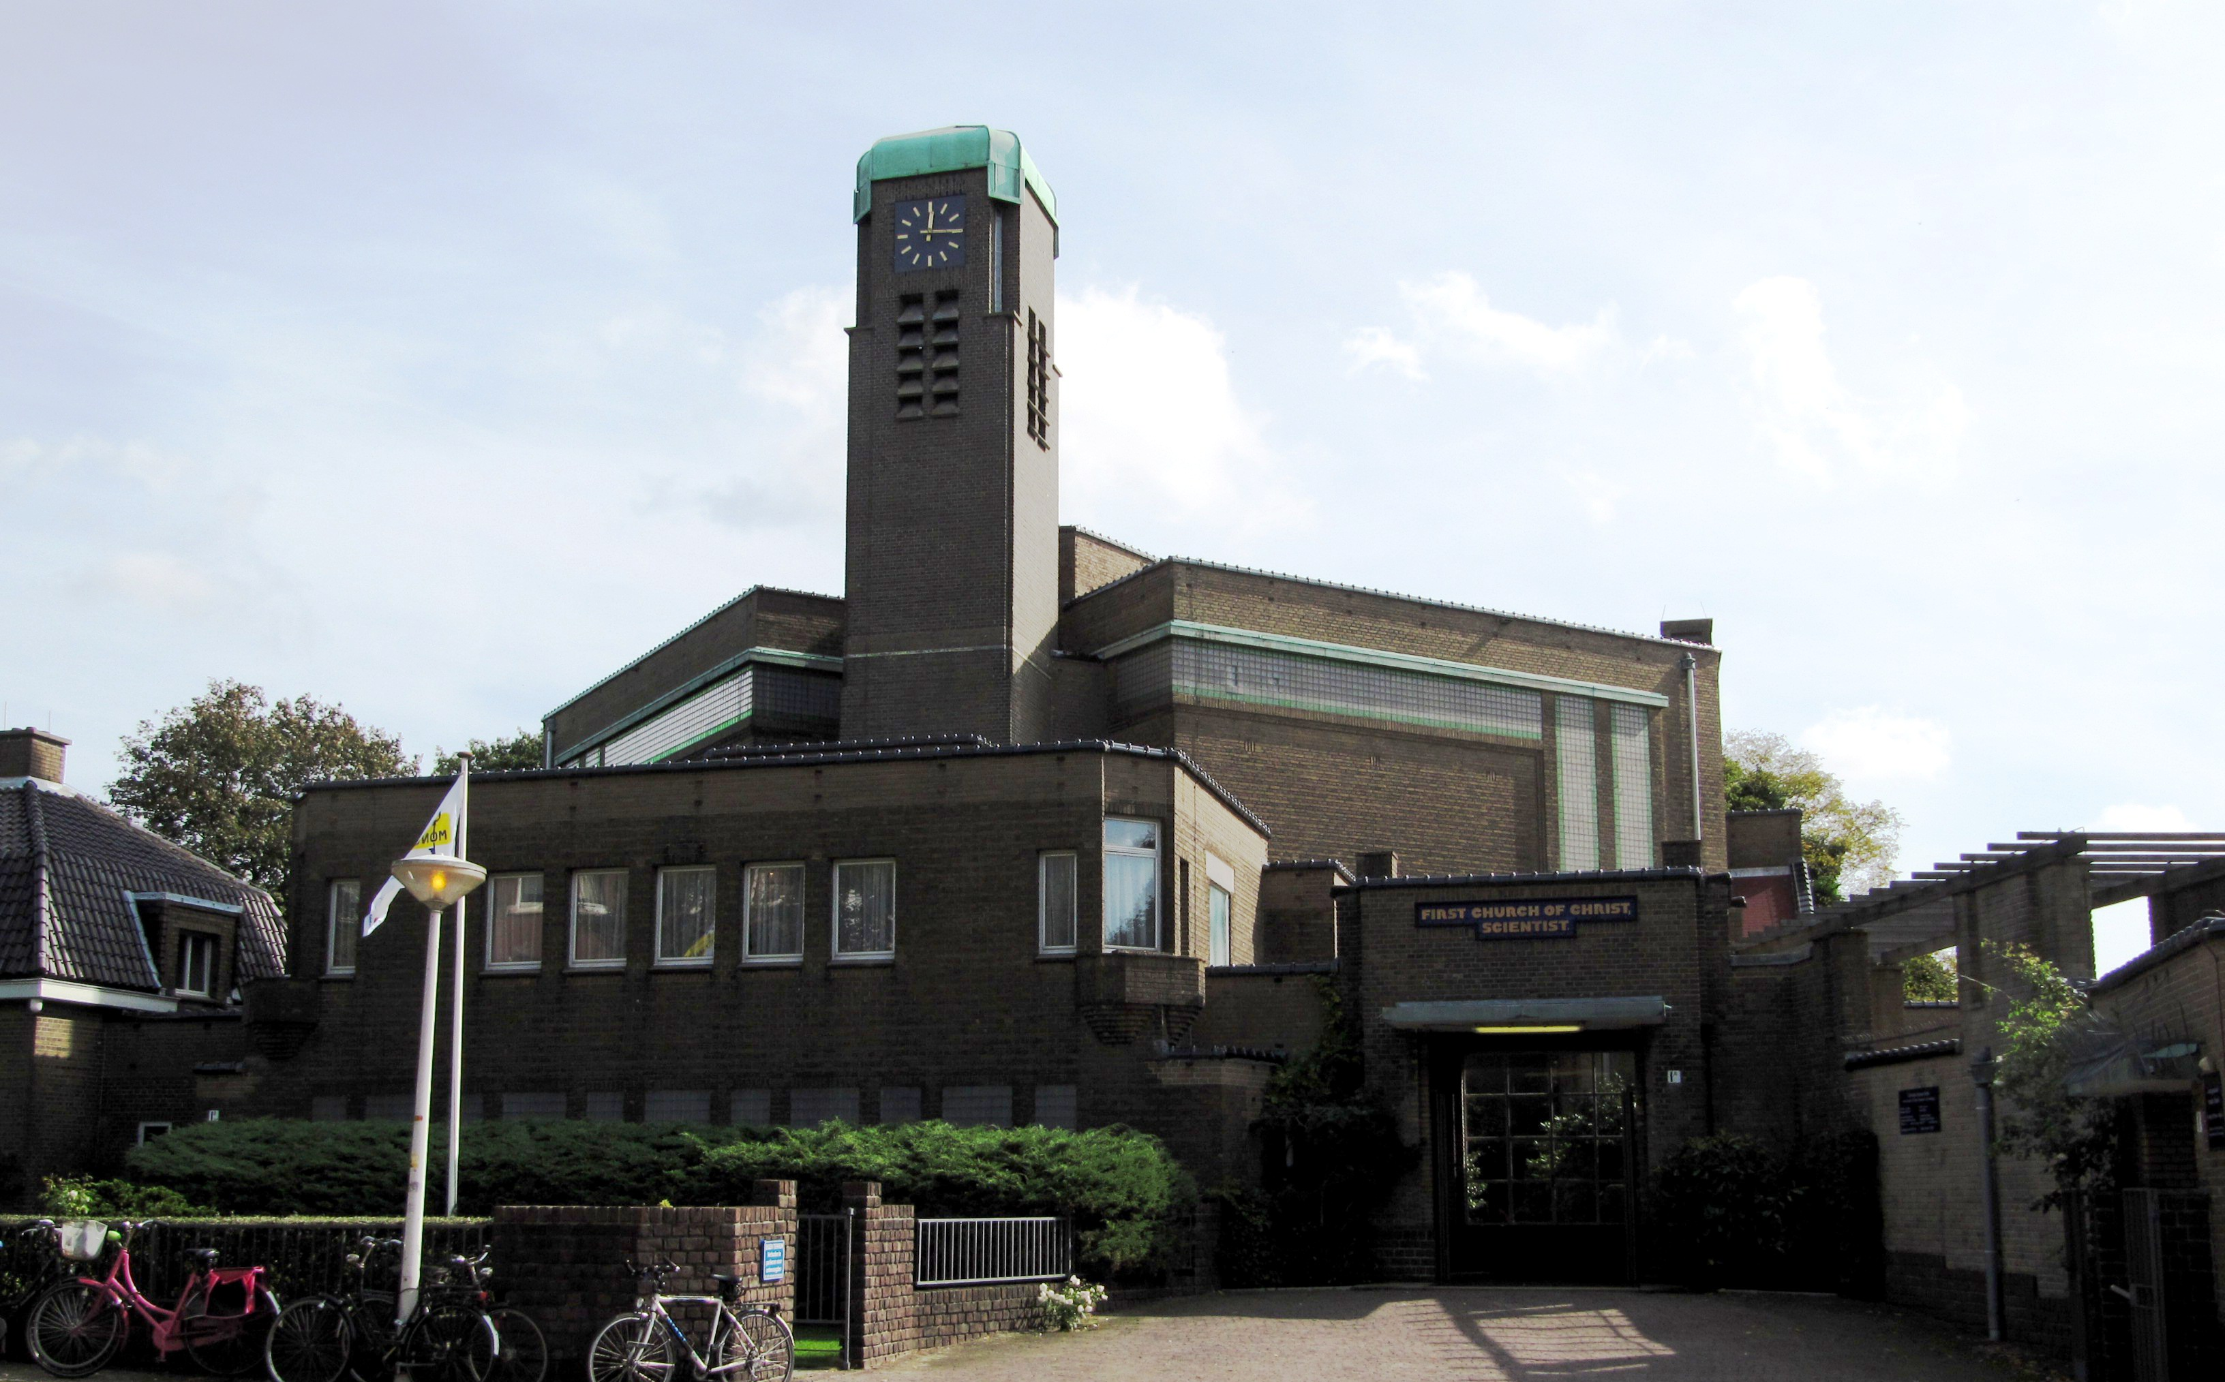
New Styles
Later, modernist architects were also hired, such as Hendrik Petrus Berlage (1856-1934) for the church in The Hague (left)

Slide 6
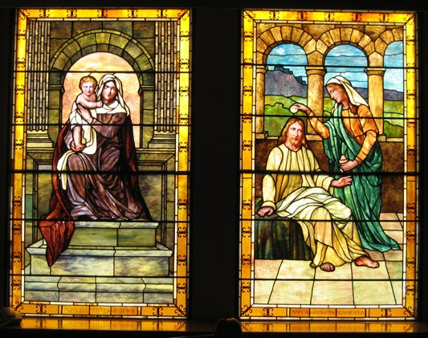
Stained Glass Windows
The stained glass windows of the Mother Church in Boston were prepared by the local company of Phipps Slocum & Co., under the direction of Christian Science leadership, in the same conventional style. Some comments emphasized the prevalence of female characters, which was somewhat typical of early Christian Science imagery

Slide 7
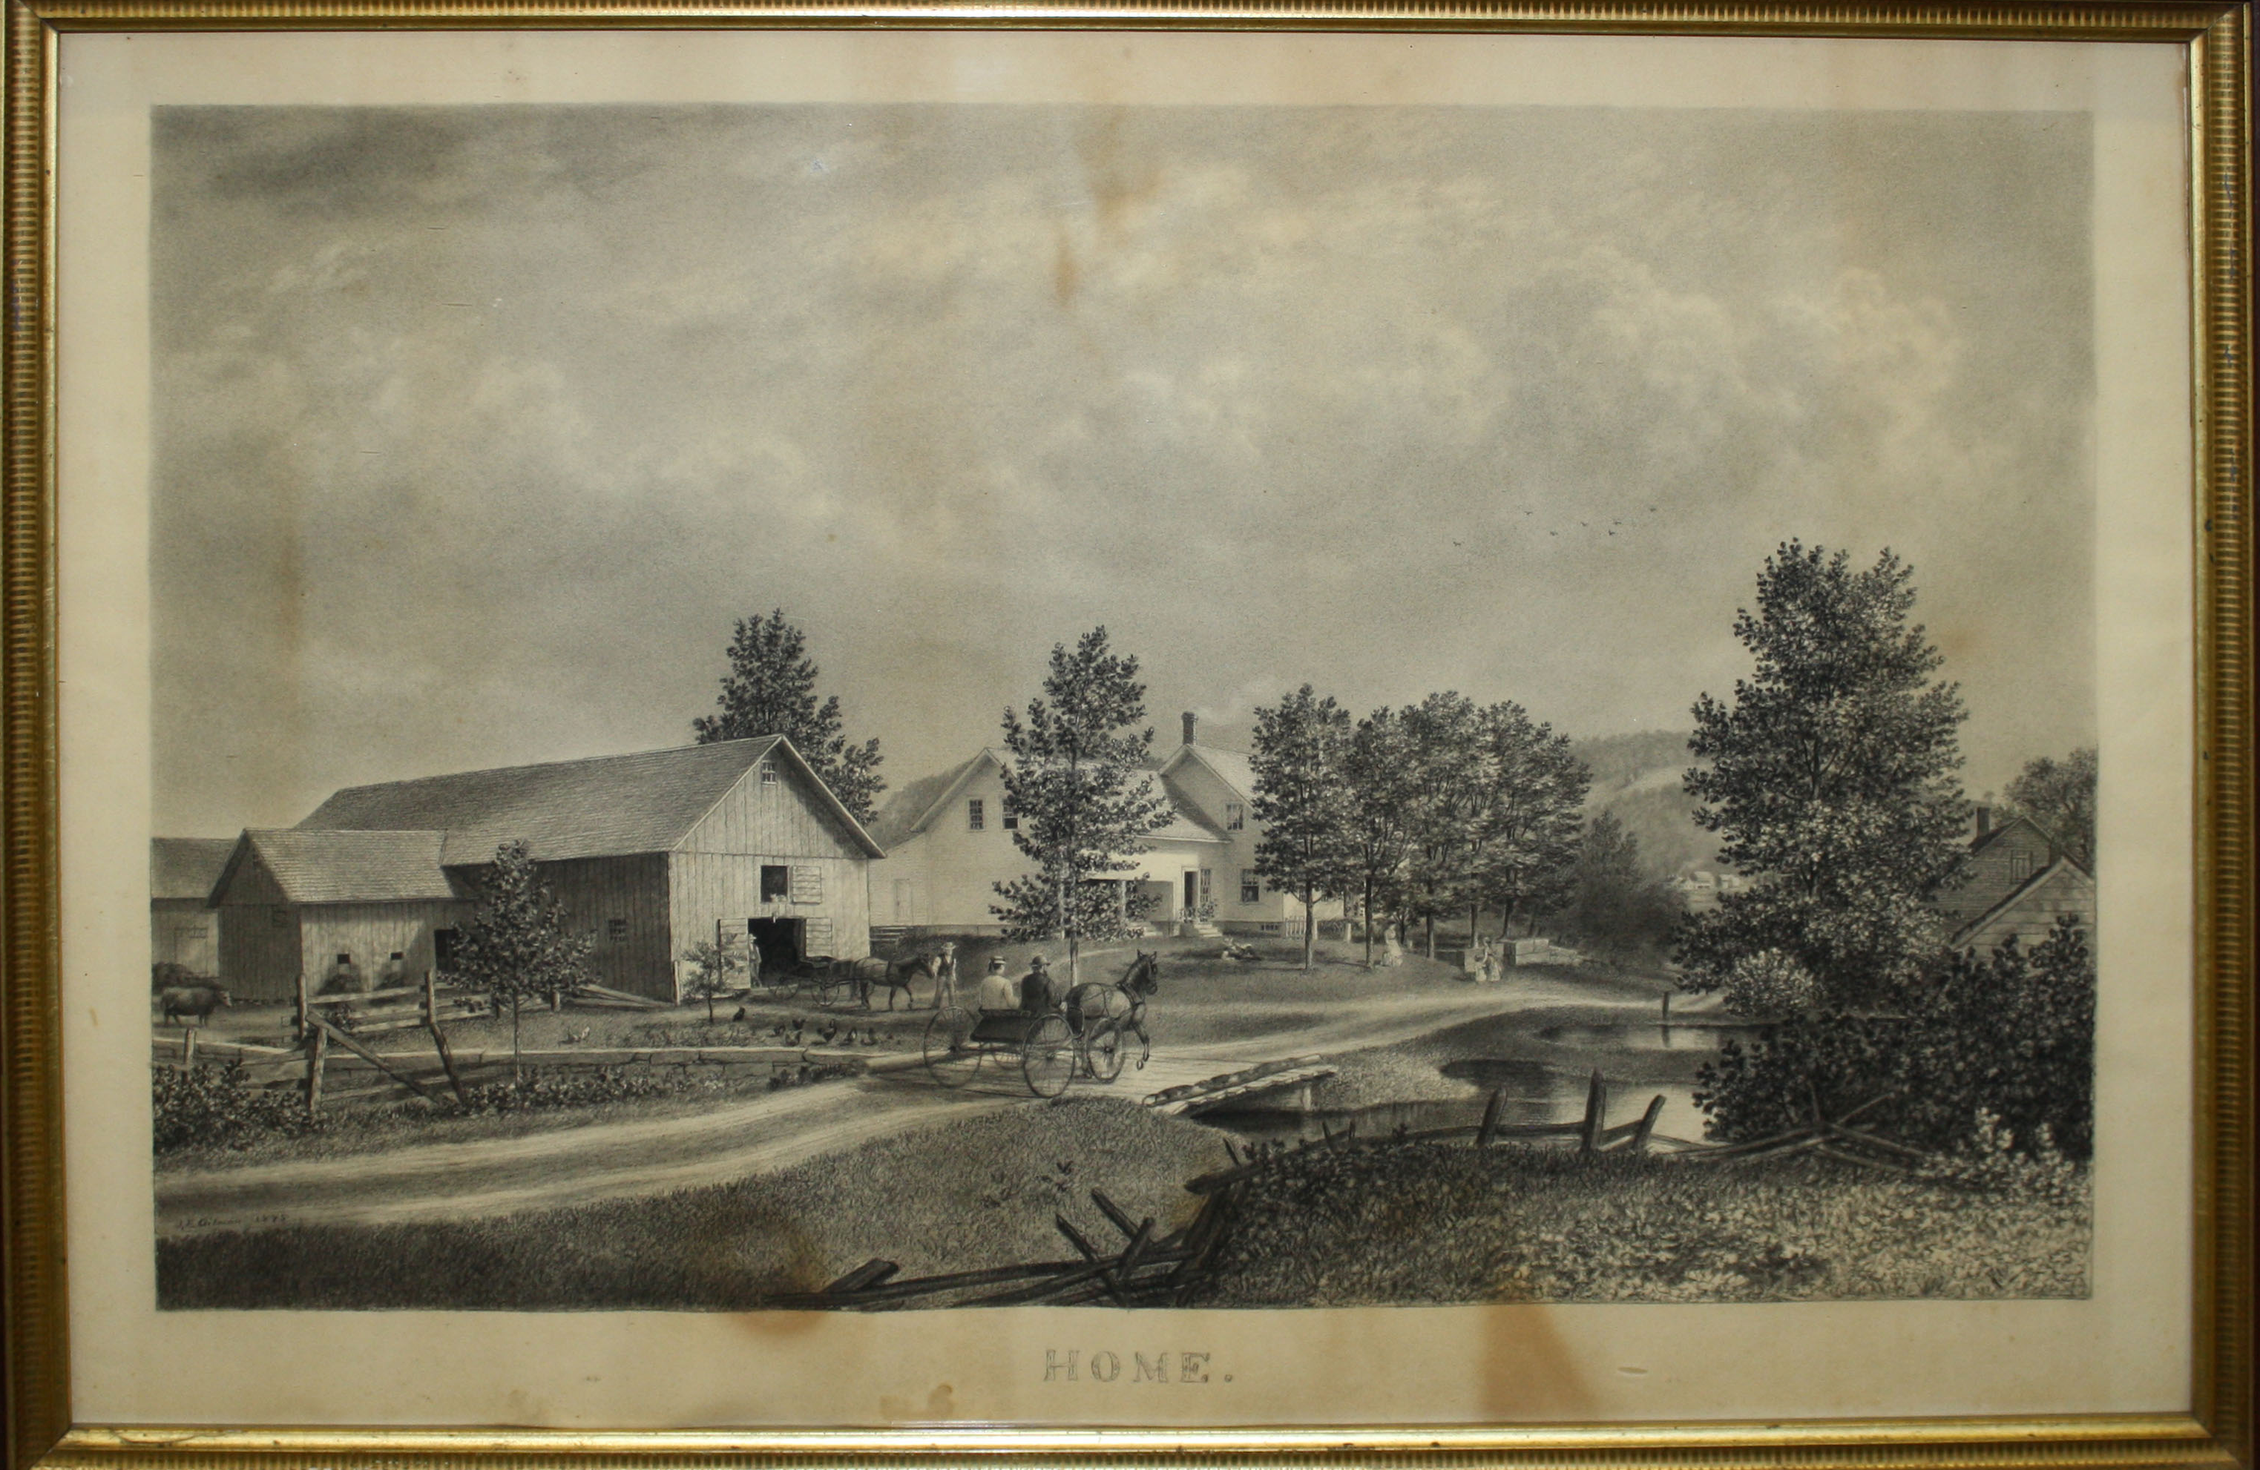
James Franklin Gilman
James Franklin Gilman (1850-1929: Home, 1875, above), an itinerant artist who came from Vermont to Massachusetts, was the first professional painter involved in Christian Science

Slide 8
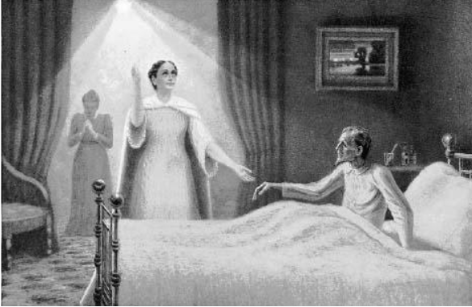
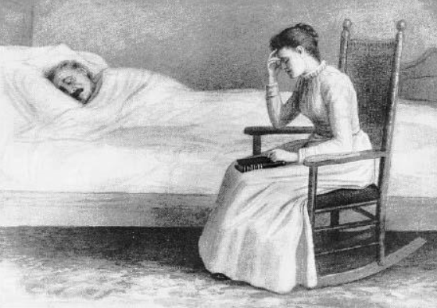
Christ and Christmas
In 1893, Gilman – who later left Christian Science – worked with Mrs. Eddy to illustrate her poem Christ and Christmas. The illustrations largely told the story of Mrs. Eddy, although she wrote that they «refer not to personality, but present the type and shadow of Truth's appearing in the womanhood as well as in the manhood of God, our divine Father and Mother»*
* Eddy, Miscellaneous Writings 1883-1896, 1924 ed., 43

Slide 9
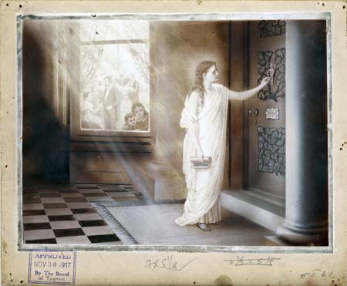
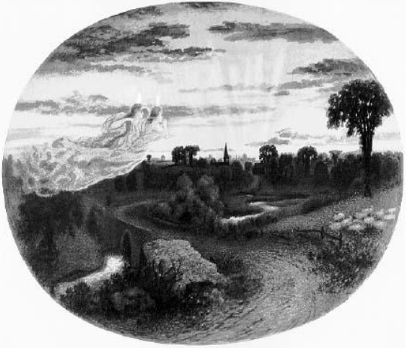
A Didactic Art
Christ and Christmas was an extraordinary cooperative enterprise between a religious leader and an artist, as evidenced by the changes Eddy requested for subsequent editions (left). What Mrs. Eddy sought from Gilman was, at that time, a didactic art illustrating the truths of Divine Science

Slide 10
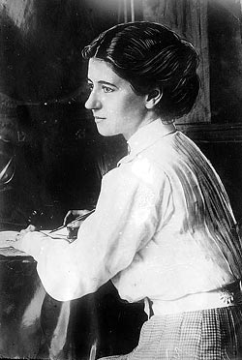
Violet Oakley
But what about an art inspired by Christian Science principles but not directly illustrating its textbooks? This was a challenge for a subsequent generation of artists. In 1900, Violet Oakley (1874-1961) started a process that led to her conversion to Christian Science. She served as one of the two readers (i.e. lay ministers conducting the service) in her Christian Science church in Philadelphia for sixty years

Slide 11
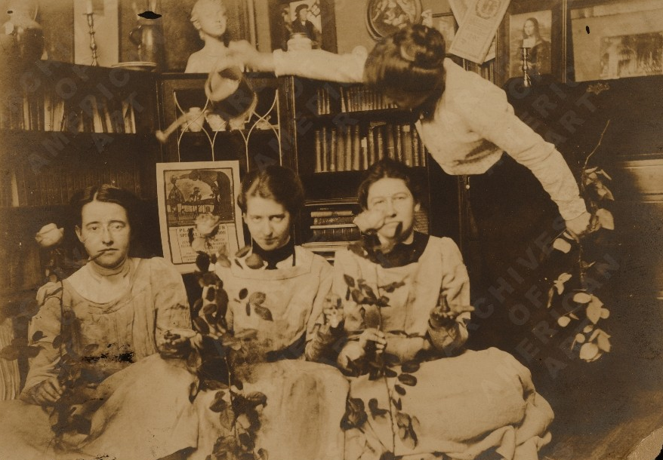
The Red Rose Girls
Together with Jesse Willcox Smith (1863-1935) and Elizabeth Shippen Green (1871-1954), Oakley was one of the three «Red Rose Girls». All well-off socialites and all pupils of the famous Swedeborgian illustrator Howard Pyle (1853-1991), the three young women decided to live together in Philadelphia’s Red Rose Inn between 1899 and 1901and to seek a place in a profession dominated by men

Slide 12
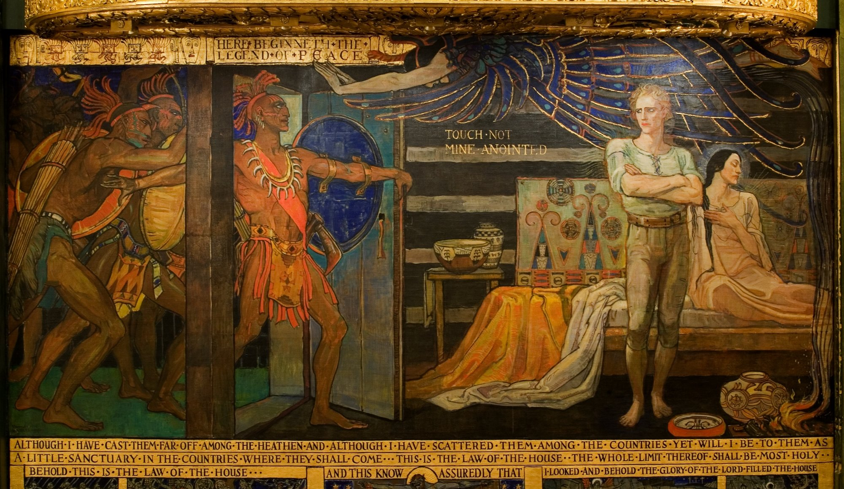
American Muralist
Oakley became famous as the first American woman to receive a public mural commission. The 43 murals in Harrisburg’s Pennsylvania State Capitol, executed between 1902 and 1927, are regarded as a masterpiece of American muralism and led to several other commissions

Slide 13
A Strong Influence
We read in the main monograph about Oakley that «her firm Christian Science beliefs strongly influenced her life and work» and that art (Light of the World, 1897 right) was for her «a way to teach moral values that would elevate the human spirit». «Sometimes her wholeheartedly devotion [to Christian Science] was refreshing, but some of her associated resented her proselytizing lectures»*
*A Sacred Challenge: Violet Oakley and the Pennsylvania Capitol Murals, Harrisburg 2002, 28

Slide 14
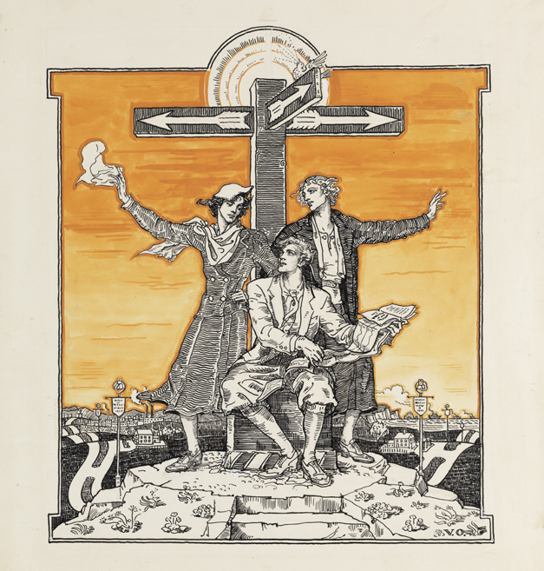
A Christian Science Artist?
Yet, we may still ask ourselves in what sense Oakley was a Christian Science artist. She worked for The Christian Science Monitor (left, illustration for a World at the Crossroads article by Democratic politician and U.S. Vice President Henry A. Wallace, 1888-1965) and occasionally painted Christian Science subjects. She claimed, however, that Christian Science inspired most of her work

Slide 15
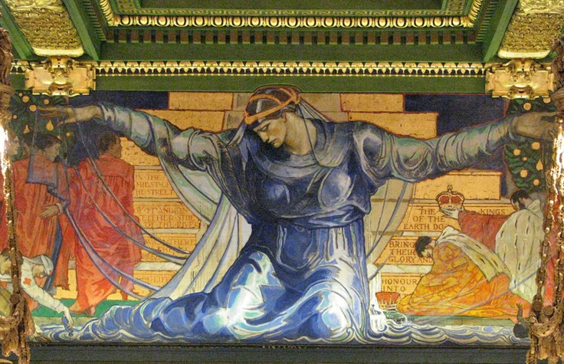
The Unity Mural
Oakley considered her best work the mural called Unity, celebrating the end of Civil War and slavery, in the Pennsylvania Senate Chamber. It expressed, she said, «beauty and harmony and inspiration and the effect of these: Peace in the mind of the beholder»

Slide 16
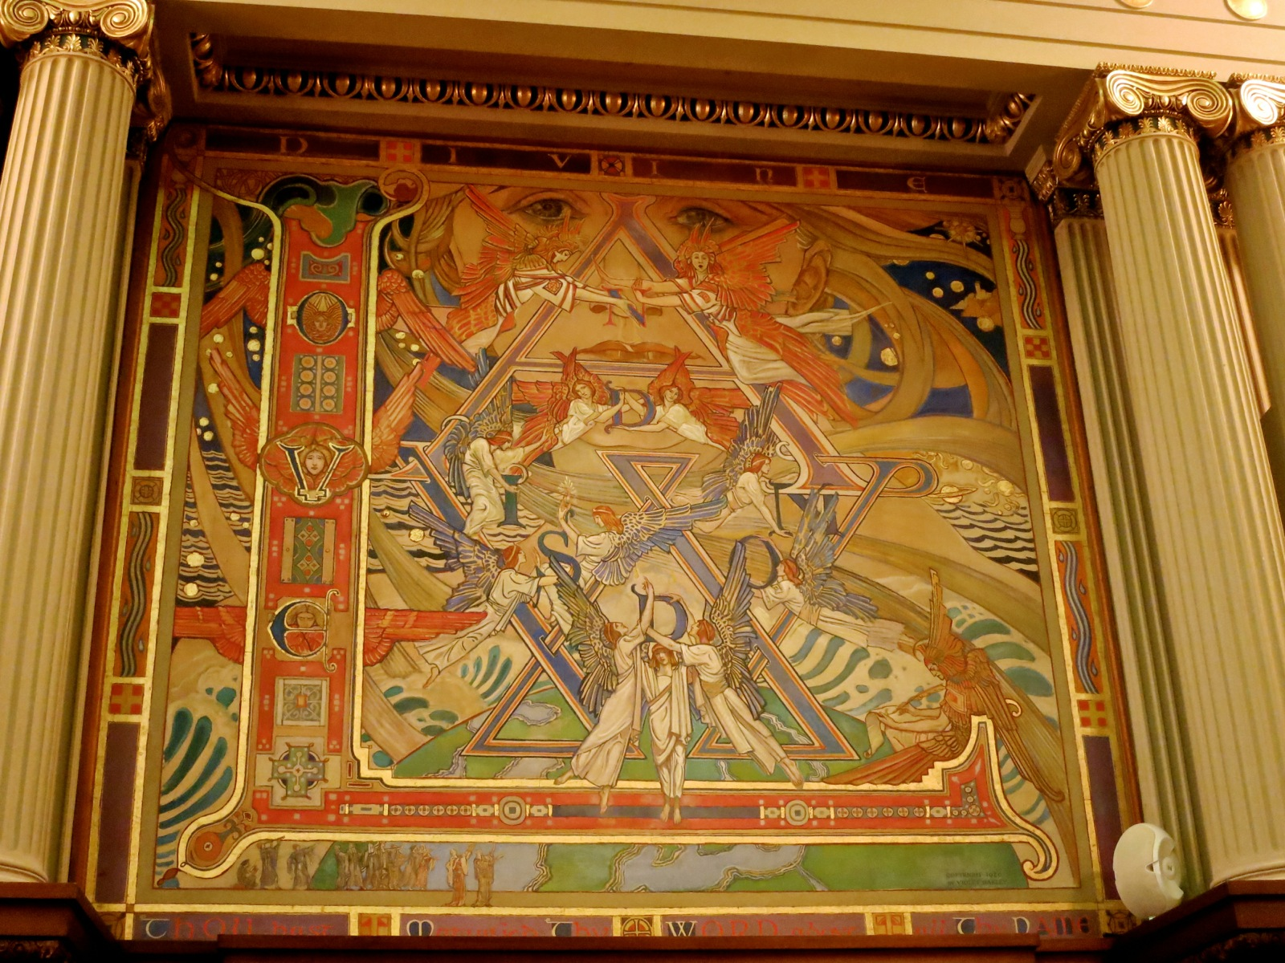
Divine Law
Some of Oakley’s murals tried to summarize more explicitly the tenets of Christian Science. They include Divine Law: Love and Wisdom, her first mural for the Pennsylvania Supreme Court. Angels carry the letters forming the words «Love and Wisdom» and the Divine Truth, half-concealed, half-revealed, looms in the background

Slide 17
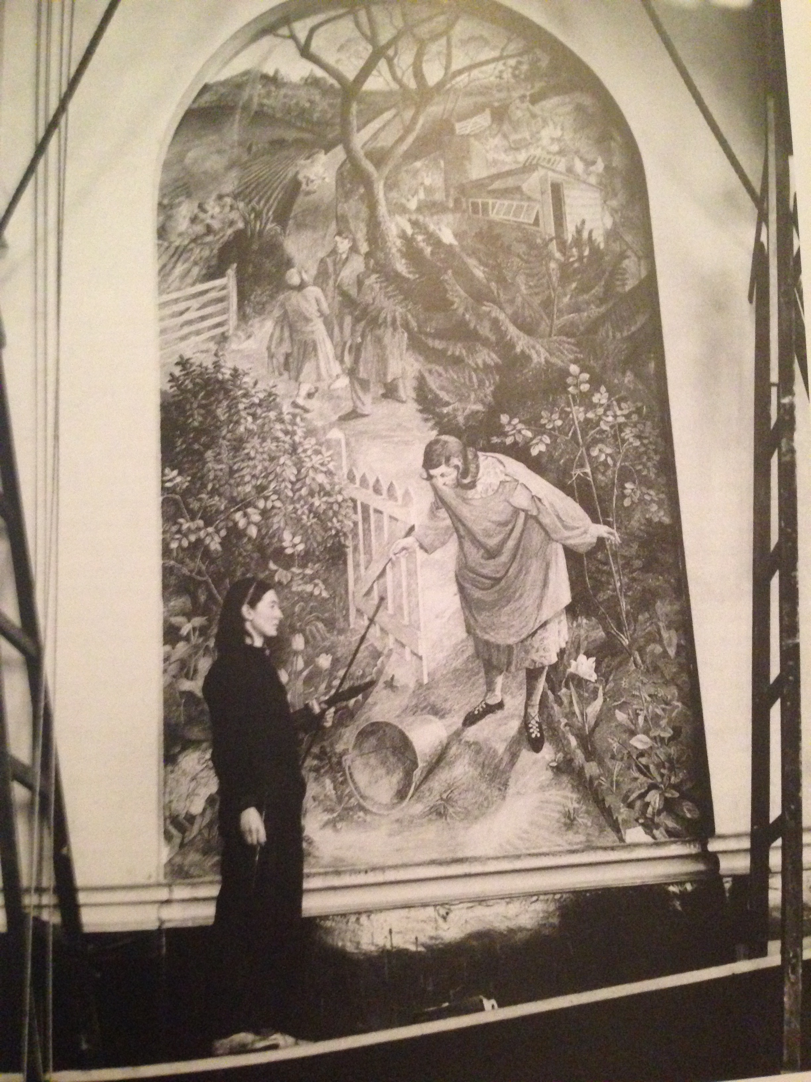
Evelyn Dunbar (1903-1968)
Coincidentally, British Christian Science painter Evelyn Dunbar also started her career as a muralist, working under her Royal College of Arts teacher Charles Mahoney (1903–1968) in the Brockley County School for Boys, South London (The Country Girl and the Pail of Milk, 1936, left)
Mahoney and Dunbar’s otherwise close relationship was always plagued by the fact that he was an agnostic and she was born into Christian Science and very committed to her religion

Slide 18
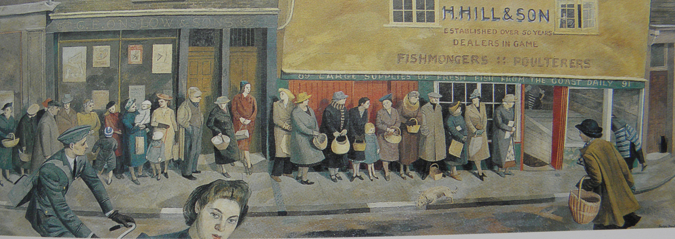
War Artist
Hailed as one of the most promising British young painters, in 1940 Dunbar was commissioned to work as the only official UK woman war artist. She focused on the home front (The Queue at The Fish Shop, 1945, above) and became well-known during the war for her realistic and unsentimental paintings, focusing on British women

Slide 19
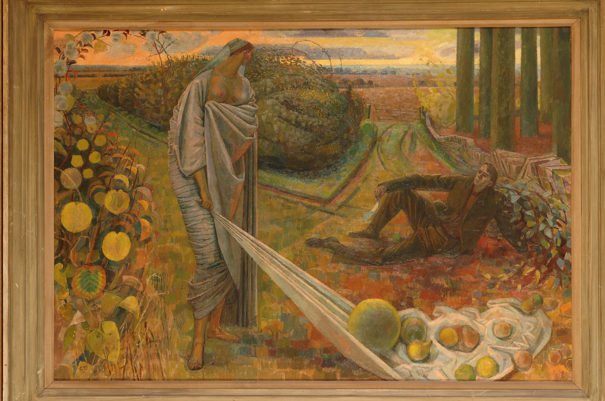
Autumn and the Poet
After the war, Dunbar settled in the Warwickshire with her husband, the economist Roger Folley (1912–2008). Folley is depicted in her Autumn and the Poet (1958-1960, above), typical of her late more metaphorical style

Slide 20
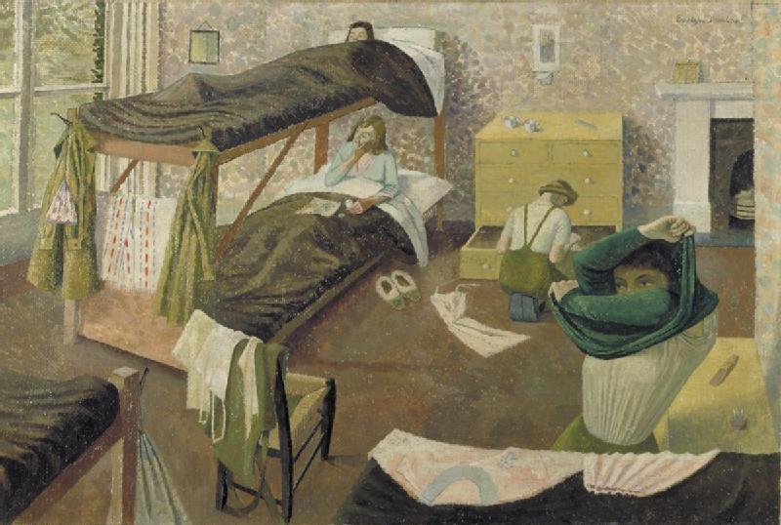
Dunbar and Christian Science
Dunbar was a very committed Christian Scientist throughout all her life. «Her Christian Science beliefs pervaded much of her work»*. Dunbar herself explained that she wanted to show that «all that is made is the work of God and all is good», while disharmony, even in a war, and evil are just delusions of the mind (Land Army Girls Going to Bed, 1943)
* Gill Clarke, Evelyn Dunbar: War and Country, Bristol 2006, 163

Slide 21
Winifred Nicholson (1893-1981)
The same feelings towards nature were expressed by Winifred Nicholson (left), a celebrated neo-Impressionist British painter who converted to Christian Science in the 1920s. She attributed to Christian Science her almost miraculous recovery after a fall during her first pregnancy in 1927. Christian Science «gradually became central to her thinking and to her art»*
*Christopher Andreae, Winifred Nicholson, Farnham - Burlington 2009, 66

Slide 22
Winifred’s Flowers
Nicholson is regarded as one of the best colorists in modern British art. She infused new life to the painting of flowers. Her flowers (Window-Sill, Lugano, 1923) showed the world as the perfect work of God and a demonstration of Divine Beauty

Slide 23
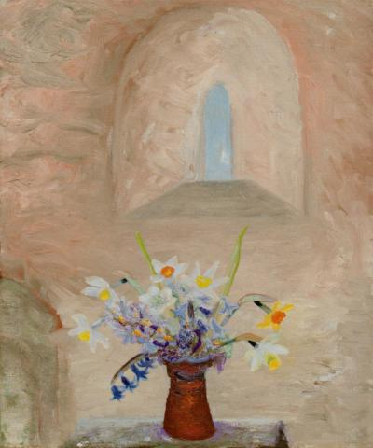
Divine Light
Daffodils and Bluebells (1950-1955) is a highly symbolic painting where the beauty of the flowers directs the gaze towards a church window and Divine Light
In 1954, Nicholson wrote in The Christian Science Monitor that these paintings represented «the still order behind turmoil», «a place where the harmony of space is giving its verdict»

Slide 24
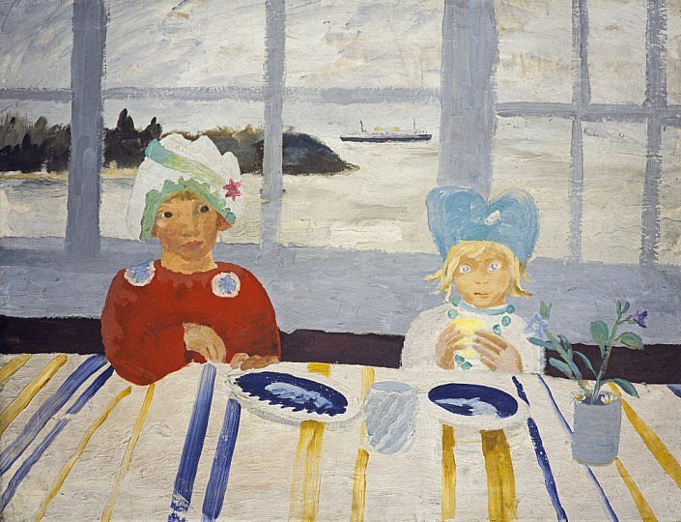
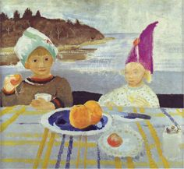
The Beauty of Children
Nicholson didn’t paint flowers and landscapes only. She found the same spiritual beauty in family life, children, the simple joys of the countryside. By her children’s accounts, «she couldn’t have been a better mother»*, and this loving relationship found a place in her art (Kate and Jake, Isle of Wight and Hats, 1931-32, above)
*Andreae, 92

Slide 25
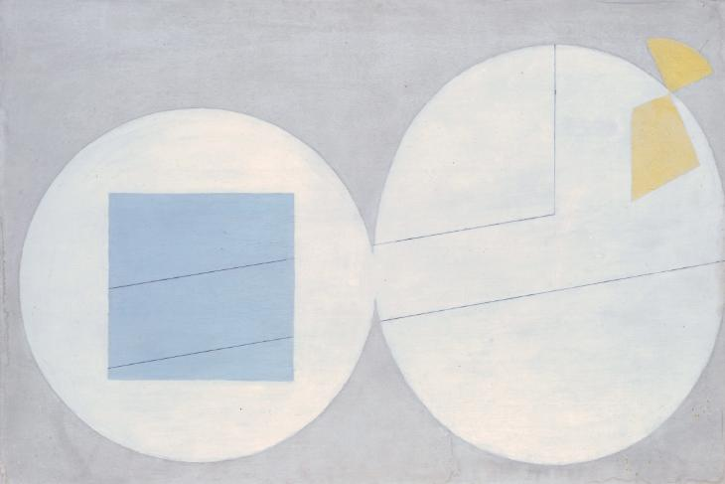
Abstract Experiments
Nicholson experimented with the abstract as a way of capturing the essence of world’s beauty and goodness as early as 1935. The title Quarante Huit Quai d’Auteuil (left) refers to her address in Paris, where she started a lifelong friendship with Dutch abstract painter Piet Mondrian (1872-1944)

Slide 26
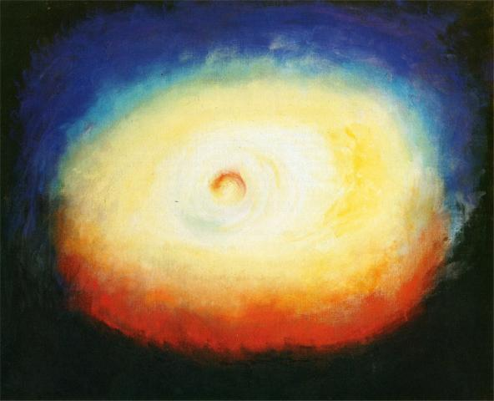
Light and Divine Science
From the abstract experiments, Nicholson consistently returned to flowers. Later in life, however, she formed a close association with Chinese abstract painter Li Yuan-Chia (1929-1994)
Under his influence, she experimented with prisms, producing a whole series of painted meditations about light, a symbol of Christ and of Divine Science dispelling the errors of the mortal mind (Consciousness, 1980, right)

Slide 27
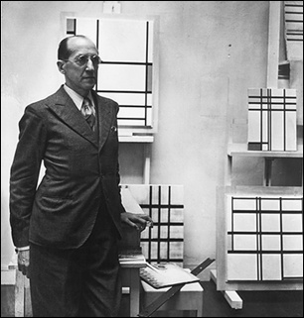
Christian Scientists and Theosophists
Mondrian (right), a very committed Theosophist, found a congenial spirit in Nicholson. Artists who were respectively Christian Scientists and Theosophists often befriended each other, and some went from Christian Science to Theosophy

Slide 28
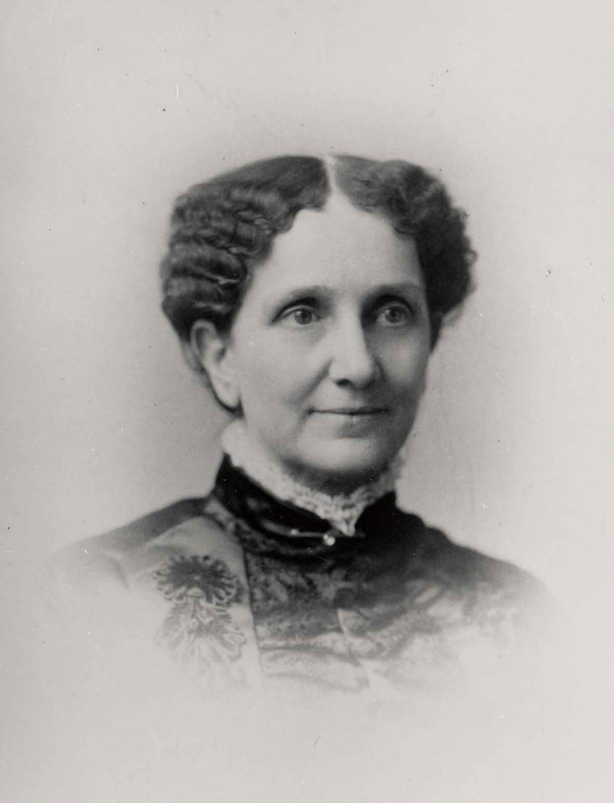
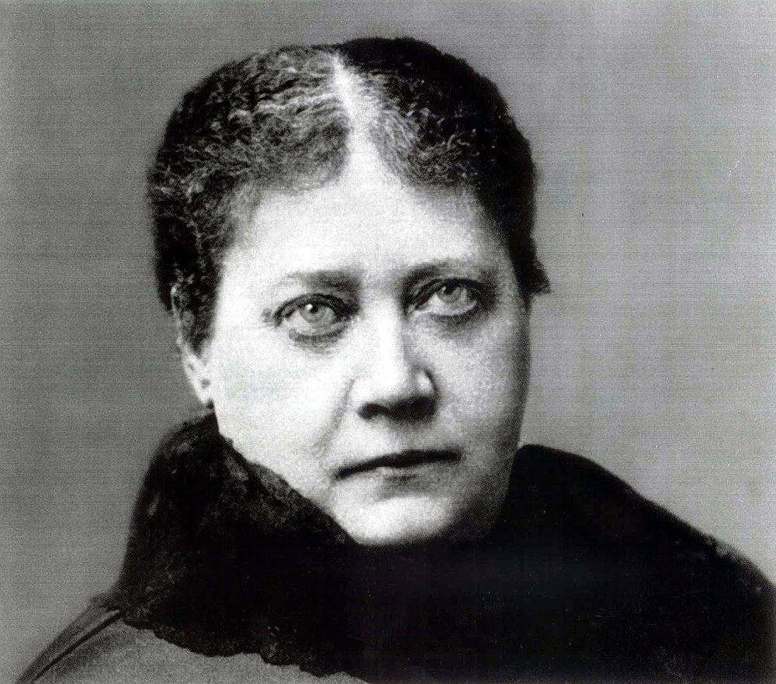
Eddy vs Blavatsky
The Theosophical Society was founded in New York only two weeks after the first publication of Science and Health. Both movements were founded by women and found followers in the same urban and progressive milieu. The two teachings were, however, «wholly irreconcilable»*. Theosophy’s founder, Helena Blavatsky (1831-1891, below), attacked Christian Science as a wrong interpretation of human psychic and occult powers, and Mrs. Eddy (above) regarded Theosophy as a particularly malignant form of animal magnetism, i.e. of the malicious attempt to control other human minds
* Stephen Gottschalk (1941-2005), The Emergence of Christian Science in American Religious Life, Berkeley - Los Angeles - London 1973, 156

Slide 29
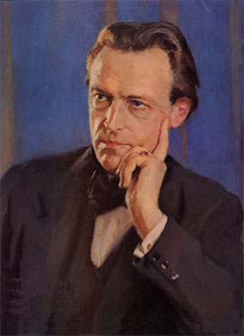
Friendly Relationships
Notwithstanding this doctrinal conflict, relationships between individual Theosophist and Christian Scientists were often good, particularly in the artistic milieu. The well-known British composer Cyril Scott (1879-1970, right), who was first interested in Christian Science and later became a Theosophist, claimed that he was introduced to Theosophy through Christian Science friends

Slide 30
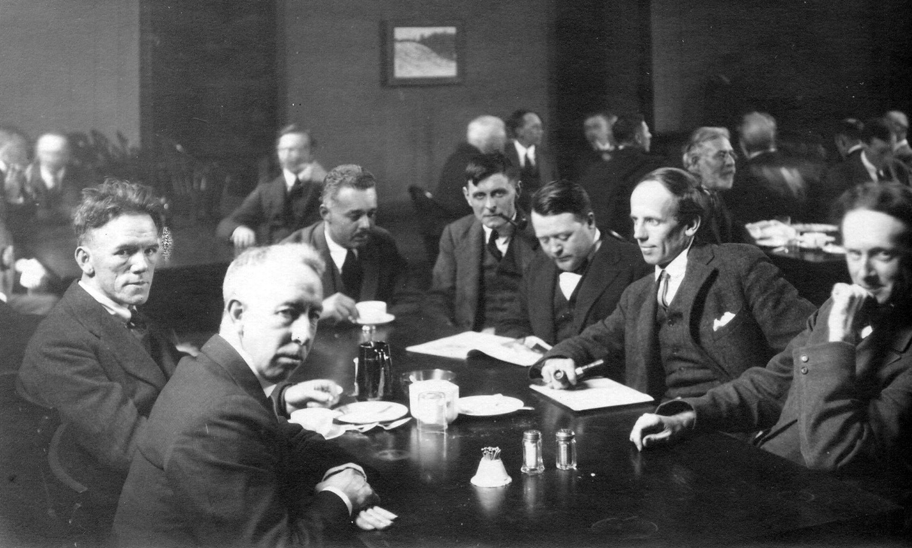
Canada’s Group of Seven
A case in point is the Group of Seven (left), Canada’s most significant 20th century group of artists. The founder, Lawren Harris (1885-1970) had a Christian Science mother but later moved to Theosophy. Among the members, James Edward Hervey MacDonald (1873-1932) was a Theosophist with a Christian Scientist wife, and Frank Hans (Franz) Johnston (1888-1949), was a Christian Scientist

Slide 31
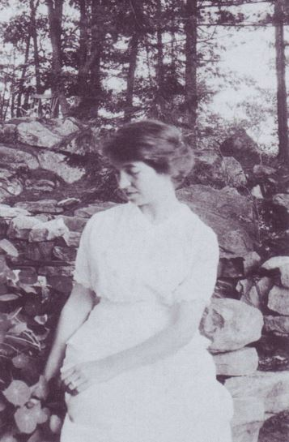
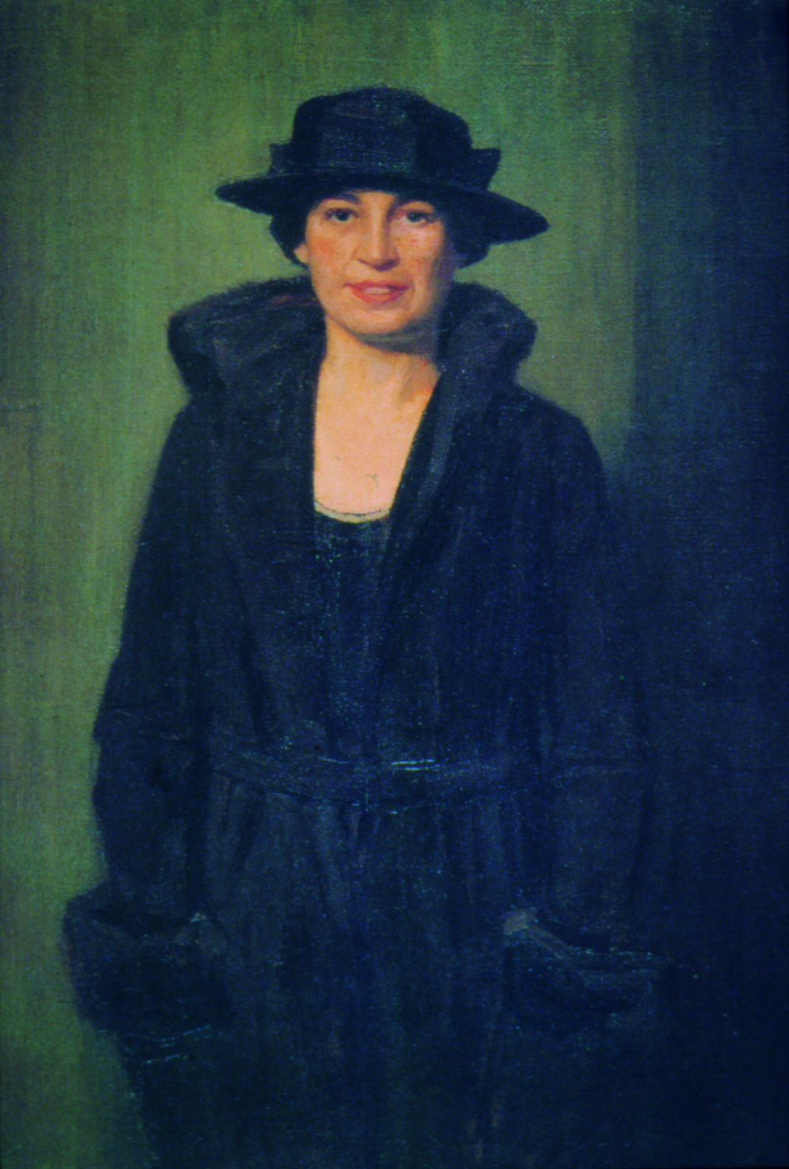
The Christian Scientist
Harris’ beloved second wife Bess Housser (1891-1969, left), was a Christian Scientist who later became herself a Theosophist. In 1920, long before they got married, Harris painted her as The Christian Scientist (right). Almost all members of their circle of friends were either Theosophists or Christian Scientists

Slide 32
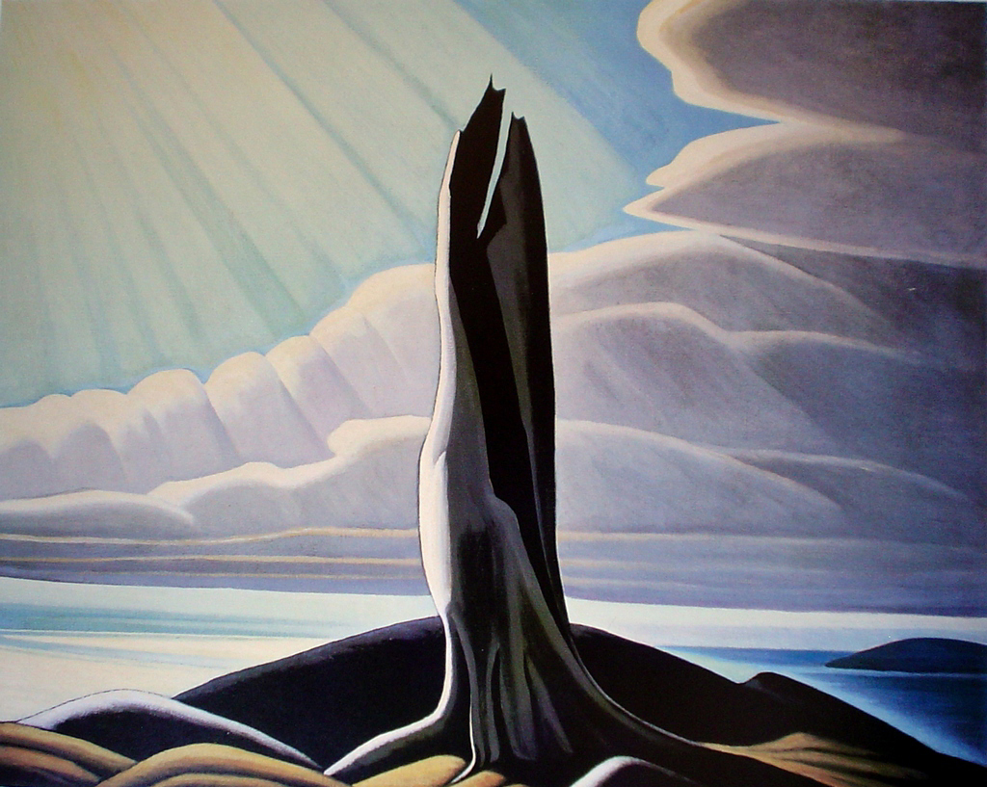
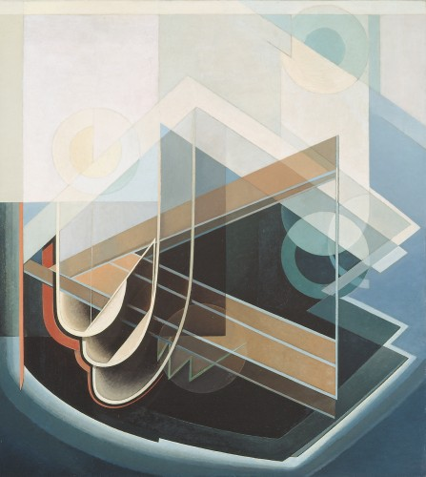
Harris and Animal Magnetism
Although firmly committed to Theosophy, Lawren and Bess Harris continued to rely on the key Christian Science concept of animal magnetism. Harris became concerned that art could inadvertently become a vehicle of animal magnetism, when it tried to influence through symbols. This eventually contributed to the passage from his signature Canadian landscapes (North Shore, Lake Superior,1926, left) to the abstract works of his later years (Abstract no. 7, right)

Slide 33
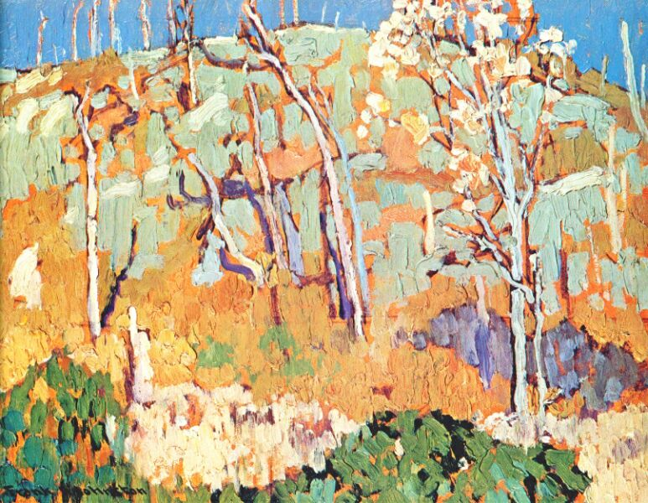
Franz Johnston
Johnston (Patterned Hillside, 1918, right) was the only member of the Group of Seven who «remained a faithful and devout follower [of Christian Science] all his life. He started each day with a prayer and Bible reading»*
*Roger Burford Mason, A Grand Eye for Glory: A Life of Franz Johnston, Toronto 1998, 21

Slide 34
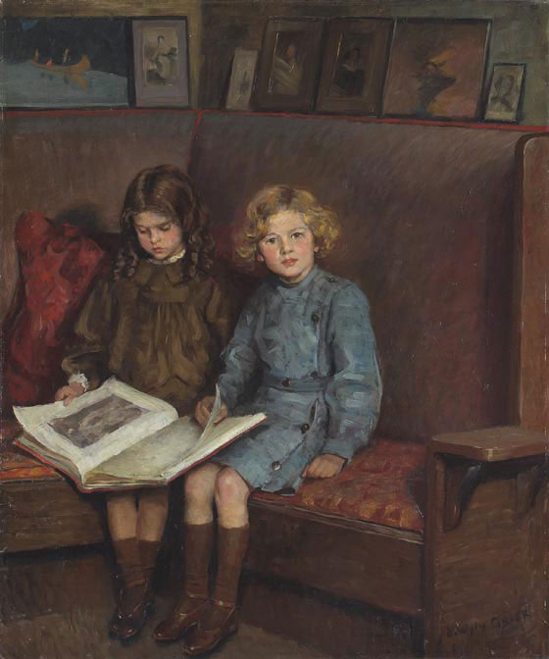
Edmund Wyly Grier (1862-1957)
Johnston was persuaded to join Christian Science by Sir Edmund Wyly Grier (Portrait of Artist’s Children, ca. 1909, left), an academic portrait painter who would go on to become in 1929 the president of the Royal Canadian Academy of Arts. Although his «traditionalist» style quickly went out of fashion, Grier should be added to the list of recognized artists who were loyal Christian Scientists

Slide 35
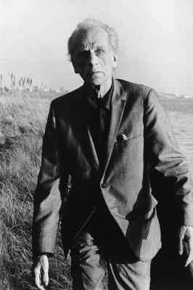
Joseph Cornell (1903-1972)
Harris’ implication that somewhat parallel conclusions about the arts may be deduced from Christian Science and Theosophy, as theoretically irreconcilable as the two systems may be, leads us again to the question of what kind of aesthetics an artist may derive from Christian Science. This was a lifelong problem for Joseph Cornell (right), perhaps the most important Christian Science artist

Slide 36
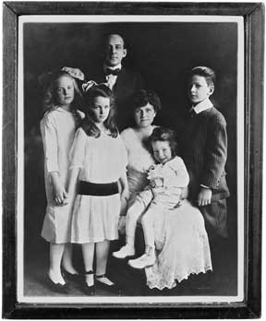
Conversion
Joseph Cornell came from a well-to-do New York family (left), but the premature death of his father when he was 14 left him as the breadwinner for his family, including mother, two younger sisters, and a brother who suffered from cerebral palsy. Joseph himself was tormented by severe stomach aches
In 1925, he turned to Christian Science, experienced a «significant healing» and became a lifelong and enthusiastic member of the church

Slide 37
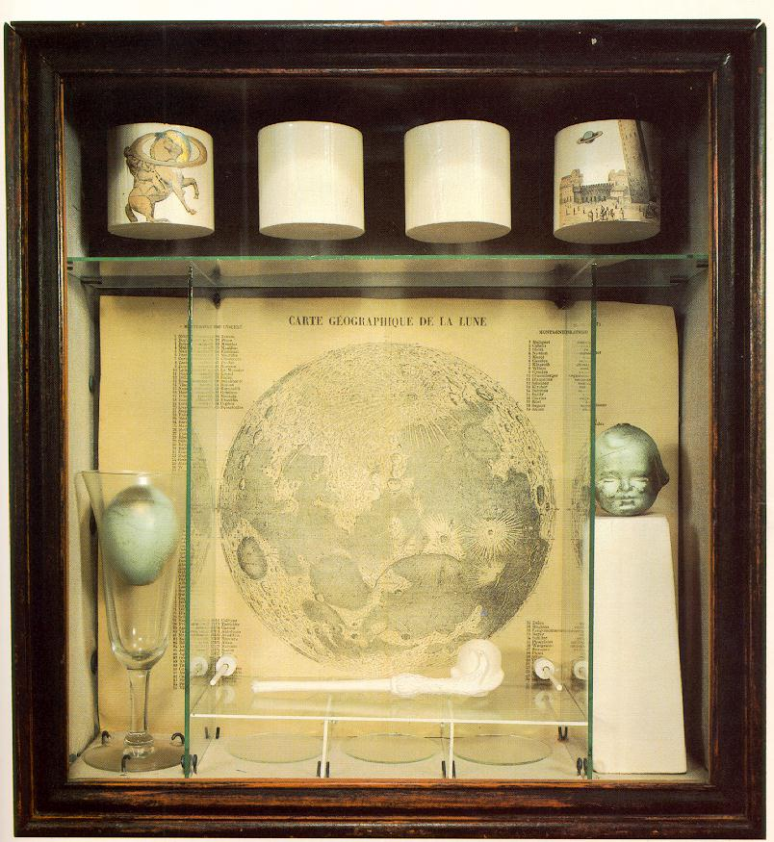
Turning to Art
Cornell’s journals make abundantly clear that Christian Science became a primary interest in his life. He credited Christian Science with «the supreme power to meet any human need»
He turned to art in the 1930s as a way to «affirm his faith». He started preparing collages and «boxes» (Soap Bubble Set, 1936, right) in order to «organize… the world of matter into the conceptual realm advocated by Christian Science»*
* Erika Doss, «Joseph Cornell and Christian Science», in J. Edwards - S.L. Taylor (eds.), Joseph Cornell: Opening the Box, Bern 2007, 113-135 (122-123; 115)

Slide 38
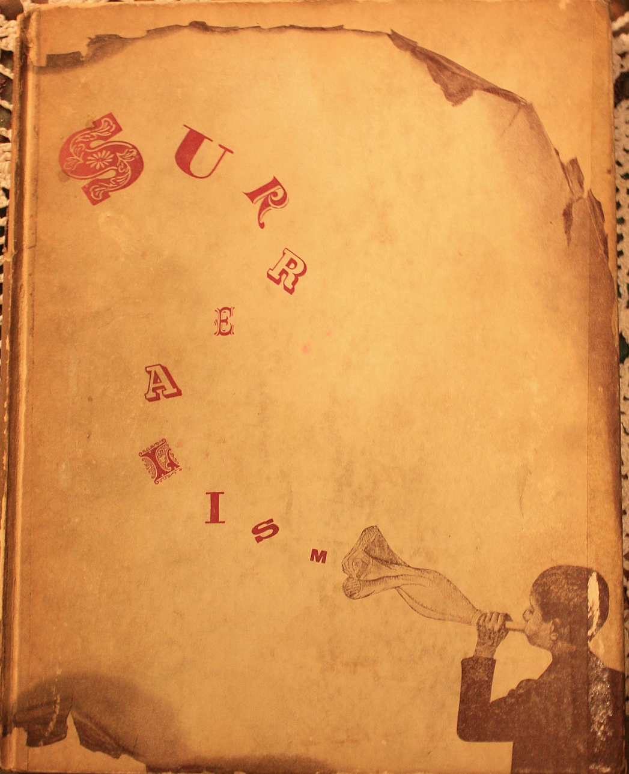
Meeting Surrealism
Later in life, Cornell stated: «I can’t draw, paint, sculpt, make lithographs». Self-taught, he was «discovered» in 1932 by New York gallerist Julien Levy (1906-1981), who introduced him to Salvador Dalí (1904-1989) and invited him to exhibit with the Surrealists. In 1936, Cornell produced the front cover for Levy’s book Surrealism (right)

Slide 39
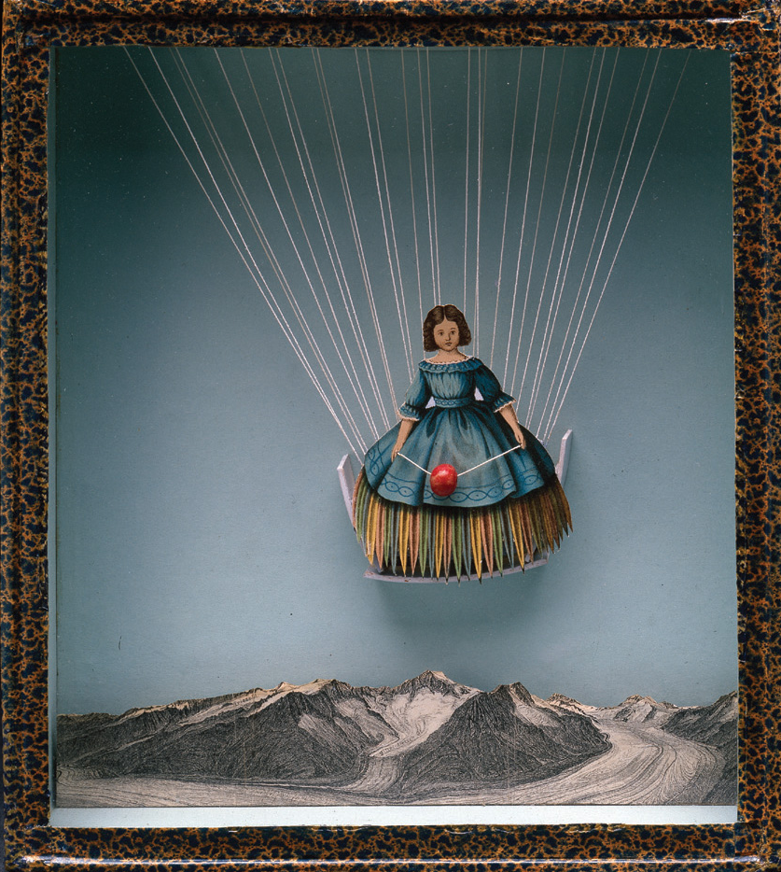
Surrealism: A Misunderstanding
Mistaken for a Surrealist after works like Tilly Losch (1936, left), and included in an exhibition of Surrealists at MoMA in 1936, he wrote to curator Alfred Barr (1902-1981) that he was not one and did not «share in the subconscious and dream theories of the Surrealists». For a fervent Christian Scientist, these were dangerously close to animal magnetism. His boxes were not celebrating chaos but imposing order on it

Slide 40
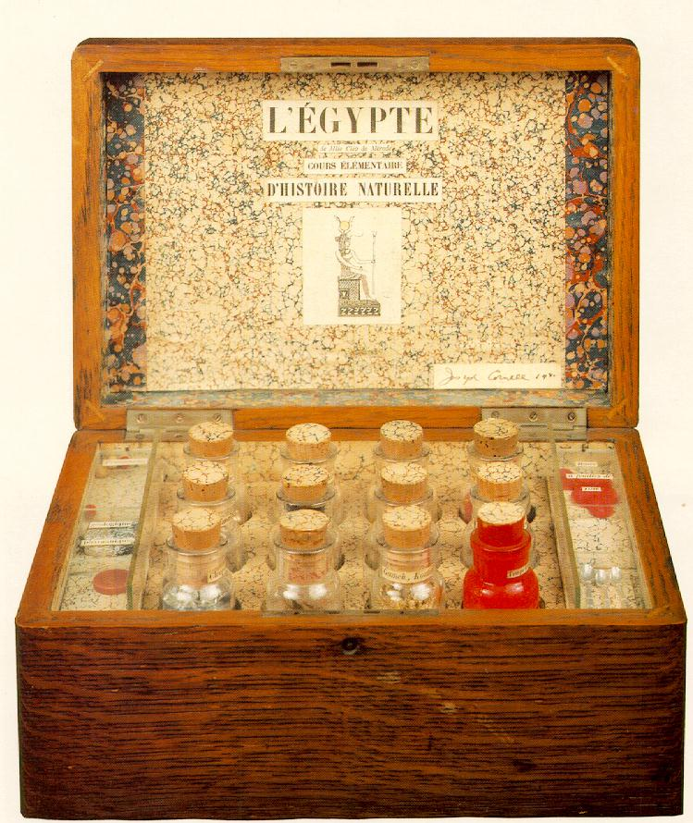
«Healthier Possibilities»
Cornell wrote to Barr that Surrealism had «healthier possibilities than have been developed». He probably referred to Marcel Duchamp (1887-1968), whom he admired and befriended. His influence shows in several boxes by Cornell (right)
Cornell, L'Egypte de Mlle Cléo de Mérode, cours élémentaire d'histoire naturelle (1940)

Slide 41
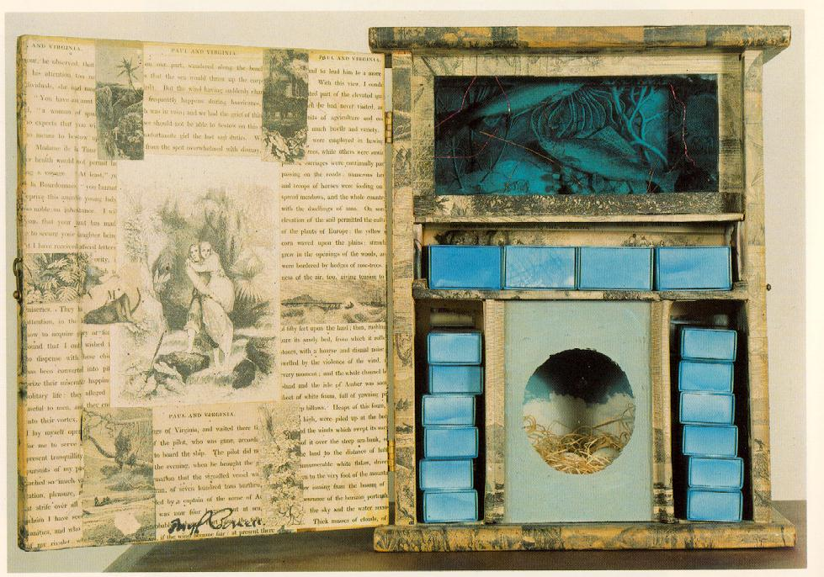
Going Beyond Duchamp
«Duchamp is Cornell’s secular and agnostic twin whom Cornell saw as an angel in danger of falling from grace». Cornell agreed with Duchamp’s idea of removing the «retinal aspect» from art, leaving only the concept, but – as a Christian Scientist – went one step further. He «begins with the finite reality of the object, proves the unreality of it and our seeing it as such, and arrives at a statement of aesthetic experience as a manifestation of spirit»*
* Sandra Leonard Starr, Joseph Cornell: Art and Metaphysics, New York 1982, 4
Cornell, Paul and Virginia, 1946-48

Slide 42
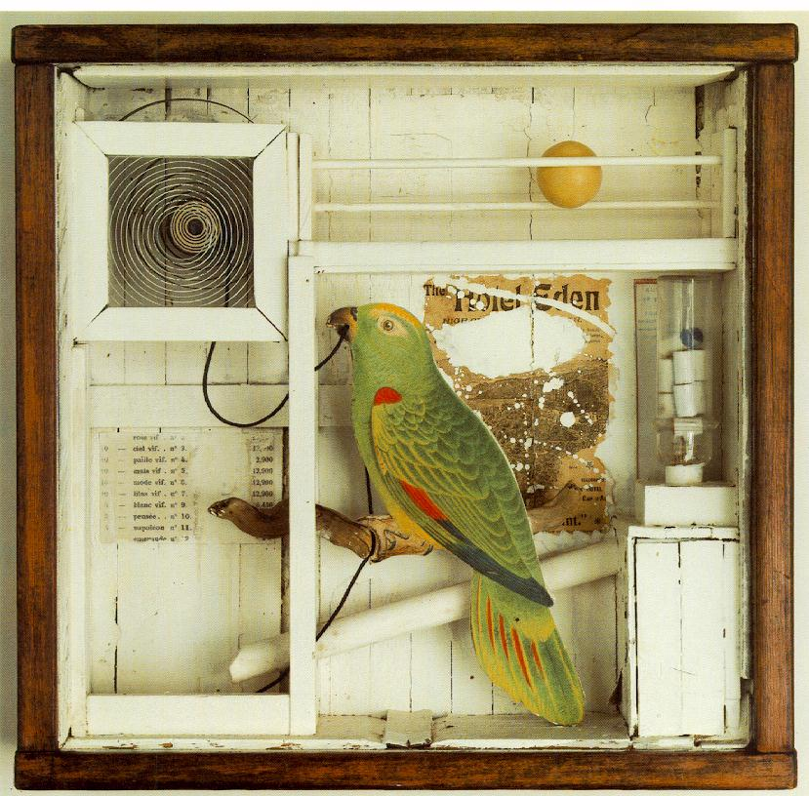
The Struggle for Cornell
Particularly at the time of the hundredth anniversary of his birth (2003), some critics tried to downplay the Christian Science element in Cornell and his boxes (Hotel Eden, 1945, left). But in fact «all [his] work is ultimately a variation on the single theme of Christian Science metaphysics»*, according not only to interpreters but to Cornell himself
*Starr, 2

Slide 43
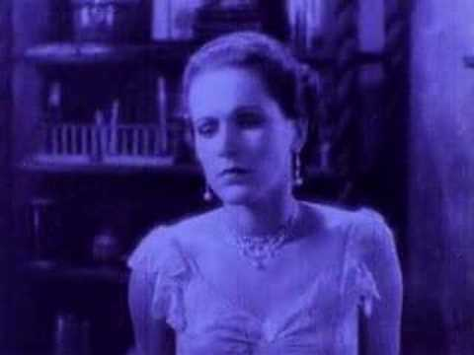
Movies and Dossiers
If the Absolute was not perceivable by visual perception, it should be sought beyond the physical confines of traditional art. In addition to boxes, Cornell produced «dossiers» of disparate clippings and objects, and «movies». These were in fact collages of parts of existing movies, starting with Rose Hobart (1936, right), a 19-minute collage film of cuttings from the Universal movie East of Borneo, starring Rose Hobart (1906-2000)

Slide 44
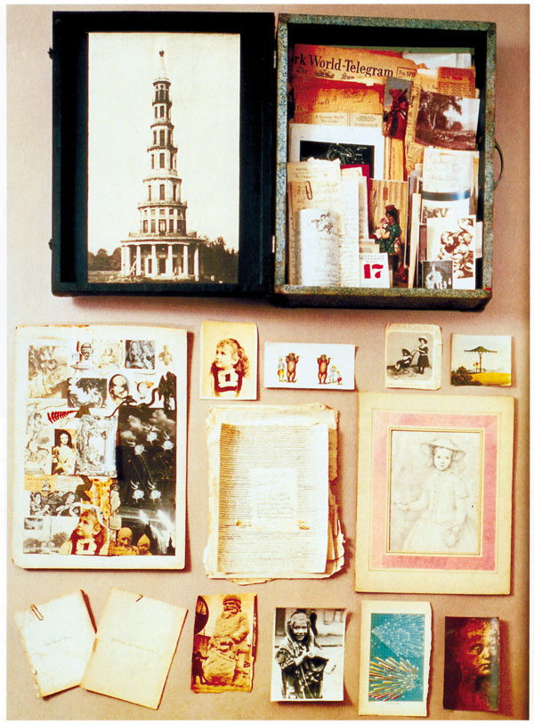
The Crystal Cage
In the assemblage of objects The Crystal Cage (1943, left), Cornell included references to Charles (Émile) Blondin (1824-1897), the French acrobat who crossed 300 times the Niagara Falls on a tightrope. Blondin epitomized for Cornell the Christian Science idea that a trained mind can triumph on physical and material limitations

Slide 45
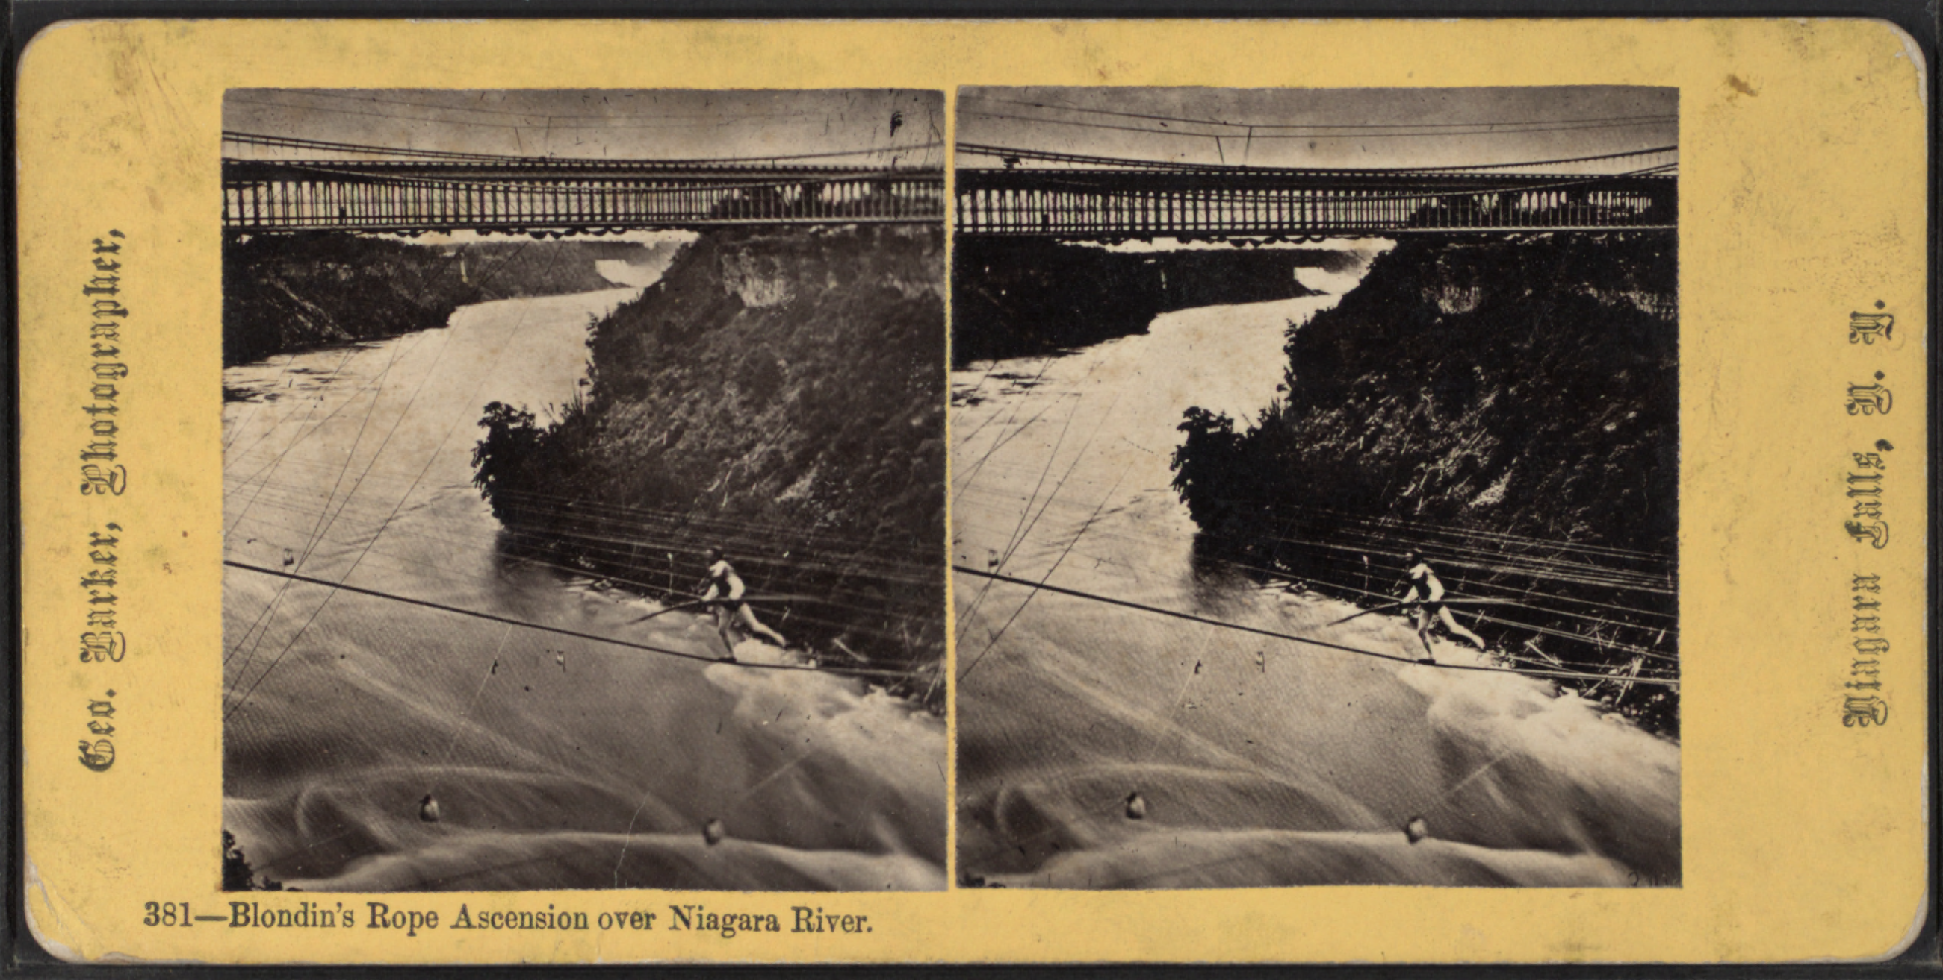
Mrs. Eddy and Blondin
Blondin was forgotten in the 20th century, but Cornell found a reference to him in Mrs. Eddy’s Science and Health: «Had Blondin believed it impossible to walk the rope over Niagara's abyss of waters, he could never have done it. His belief that he could do it gave his thought-forces, called muscles, their flexibility and power which the unscientific might attribute to a lubricating oil»*
* 1910 ed., 199

Slide 46
Actresses and Ballerinas
For the pathologically shy Cornell, the same ability of subduing mental fears was demonstrated by the evolution of ballerinas and actresses before an audience. He devoted several works to movie and ballet stars such as Lauren Bacall (1924-2014: right, 1945-46), although he also struggled with Mrs. Eddy’s warning about how easily lust may corrupt admiration for beautiful women and their art

Slide 47
Ballet and Thought-Forces
Ballet, in particular, demonstrated for Cornell the «flexibility and power of the thought-forces called muscles» mentioned by Mrs. Eddy. He was a great collector of ballet memorabilia. In a small pillbox of 1941 (right) he paid homage to Spanish ballerina Rosita Mauri (1850-1923) and to the incident where she reputedly throw her veil at the Russian Czar, disturbed that he was eating caviar with a spoon while admiring her performance

Slide 48
Cornell and Marilyn
Cornell became particularly interested in Marilyn Monroe (1926-1962) and started preparing a «dossier» on her when he learned that she had been raised Christian Scientist, first (shortly) by her mother Gladys Baker (1902-1984) and then for five years by her beloved «Aunt Ana», i.e. Ana E. Lower (1880-1948), a Christian Science practitioner with whom she lived (left) between 1938 and 1942
As a grown-up, Monroe left the faith. She never acknowledge receipt of a box Cornell sent to her

Slide 49
The Pink Palace
The Pink Palace box (1946-1950, right) was intended by Cornell as a reference to the Sleeping Beauty fairy tale (and ballet). The princess awakens after hundred years of sleep, yet she has remained young and beautiful. For Cornell, this related to Christian Science teaching about «the error of thinking that we are growing old, and the benefits of destroying that illusion»*
*Science and Health, 1910 ed., 245

Slide 50
Mrs. Eddy’s Sleeping Beauty
Mrs. Eddy (above) told the story of a British girl who, «disappointed in love in her early years, […] became insane and lost all account of time. Believing that she was still living in the same hour which parted her from her lover, taking no note of years, she stood daily before the window watching for her lover's coming. In this mental state she remained young. Having no consciousness of time, she literally grew no older»*
*Science and Health, 1910 ed., 245

Slide 51
«Years Had Not Made Her Old»
«Years had not made her old, because she had taken no cognizance of passing time nor thought of herself as growing old. The bodily results of her belief that she was young manifested the influence of such a belief. She could not age while believing herself young, for the mental state governed the physical» (ibid.)
Cornell, Compartmented Medici Princess, 1952-54

Slide 52
Palaces of the Mind
Cornell’s art aimed at creating «palaces» (Le Piano, 1948, left) free of the limitations of the matter and the mortal mind, where the mental state fully governed the physical. Perhaps, this was the true aim of all Christian Science artists

Slide 53
Thank you for your attention

